Slide 1

EduRAG: A Lightweight RAG Framework for
Academic QA
IV B.Tech II sem (2022-26 Batch, A.Y: 2025-26)
A Review-1 Presentation
Submitted for the award of B.Tech in CSE(Artificial Intelligence)
Project Guide
Dr. R Kalpana
Professor & Head
Dept. of CSE(AI)
Submitted by
Batch No: C5
22691A31E5 – SAI RAM REDDY A V
21691A31F8 – SURAKSHAN C
22691A31D6 – ROSHITHA P
22691A31E4 – SAI MEDHA K
22691A31I4 – VIGNESH REDDY S
DEPARTMENT OF CSE( ARTIFICIAL INTELLIGENCE)
MADANAPALLE INSTITUTE OF TECHNOLOGY & SCIENCE
MADANAPALLE
JAN 2026

Slide 2

Title: EduRAG: A Lightweight RAG framework for Academic QA
Agenda
Abstract and Keywords
Introduction
Literature Survey
Summary Table
Objectives of Proposed Work
System requirements
Dataset summary
Functional Modules
Proposed Architecture
Proposed Algorithm
Implementation (Source code)
References

Slide 3
Title: EduRAG: A Lightweight RAG framework for Academic QA
Abstract and Keywords
Recent advances in large language models have enabled powerful question answering systems. Motivated by recent research trends in RAG, a lightweight Retrieval-Augmented Generation (RAG) system designed for campus-level academic question answering under low-resource constraints. The framework uses structured college data stored in JSON format, which is directly chunked without recursive splitting and embedded using the Sentence-Transformers all-MiniLM-L6-v2 model. Semantic retrieval is performed via a FAISS IndexFlatL2 vector index with top-k nearest-neighbor search. Retrieved text chunks are concatenated to form a grounded context, which is passed to a Flan-T5-XL sequence-to-sequence model for answer generation using a controlled prompt that restricts responses strictly to retrieved content. The system follows a deterministic retrieve-then-generate pipeline, prioritizing factual grounding and minimizing hallucination. EduRAG is fully CPU-compatible, modular, and optimized for small-scale academic deployments such as college information assistants, demonstrating an effective balance between accuracy, simplicity, and computational efficiency
Keywords: Retrieval-Augmented Generation, Academic Question Answering, Lightweight RAG, Knowledge Retrieval, Hallucination Reduction, EducationalGeneration, Academic Question Answering, Lightweight RAG, Knowledge Retrieval, Hallucination Reduction, Educational AI

Slide 4
Title: EduRAG: A Lightweight RAG framework for Academic QA
Introduction
1.1 Introduction to domain
Educational institutions generate large volumes of structured and unstructured information related to courses, departments, facilities, academic rules, and campus events. Accessing this information through traditional keyword-based search or static web pages is often inefficient and time-consuming for students and faculty.
EduRAG is a lightweight Retrieval-Augmented Generation (RAG)–based academic question answering system designed to provide accurate, context-aware responses to campus-related queries. The system operates by first retrieving the most relevant information from a structured college knowledge base using semantic similarity search, and then generating natural language answers strictly grounded in the retrieved content.
The framework follows a retrieve-then-generate pipeline, where college data is embedded into a vector space, indexed using FAISS, and queried using dense semantic retrieval. Retrieved document chunks are supplied as context to a large language model, ensuring that generated answers remain factual and limited to verified institutional data.
EduRAG is optimized for CPU-based execution, modular design, and ease of deployment, making it suitable for small-scale academic environments such as college information assistants, internal help desks, and campus chatbots. The project demonstrates how retrieval-augmented generation can effectively reduce hallucination while improving response relevance in educational applications.

Slide 5
Title: EduRAG: A Lightweight RAG framework for Academic QA
Introduction
1.2 Introduction to Technology
The proposed solution uses Retrieval-Augmented Generation (RAG), a technology that combines information retrieval with natural language generation. In RAG, user queries are first matched with relevant documents using vector embeddings and similarity search. The retrieved academic content is then provided to a language model to generate answers strictly based on those sources. This approach reduces hallucination and improves factual grounding. EduRAG enhances this idea by using lightweight embedding models, efficient vector indexing, and optimized prompts to reduce computational cost. The system is designed to run on limited hardware while still providing accurate, source-backed academic question answering.
No lightweight RAG for education - existing systems too complex/expensive
Static knowledge bases - can't adapt to evolving curricular
Missing education-specific evaluation - no metrics for learning outcomes
Limited accessibility - high computational requirements exclude smaller institutions

Slide 6
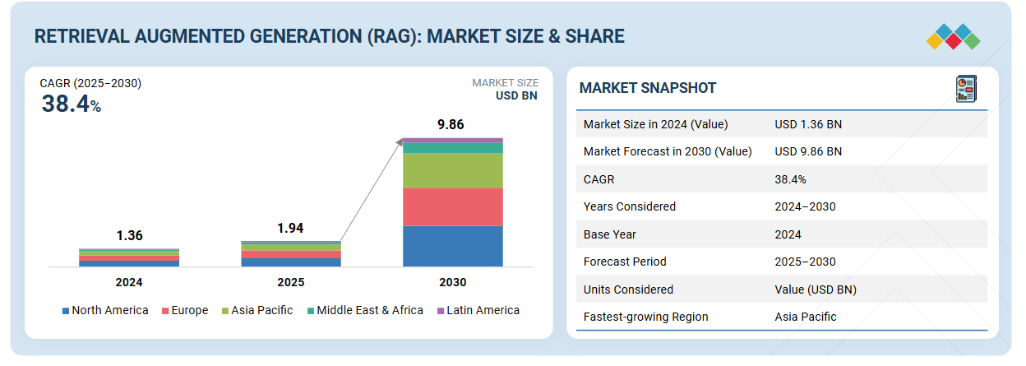
Title: EduRAG: A Lightweight RAG framework for Academic QA
Introduction
Global RAG market (2025): ~$1.9–2.0B and projected to $9.9B by 2030 (~38–49 % CAGR). Click Here

Slide 7
Title: EduRAG: A Lightweight RAG framework for Academic QA
Literature Survey
Base paper title: Hybrid Retrieval-Augmented Generation Agent for Trustworthy Legal Question Answering in Judicial Forensics
(Yueqing Xi et al., 2025) This paper proposes a hybrid RAG-based system for reliable legal question answering. The system first retrieves relevant legal documents using embeddings and FAISS; if similarity is high, answers are generated using RAG for factual grounding. If retrieval fails, multiple LLMs generate answers in parallel and a selector model ranks them based on correctness, legality, clarity, and faithfulness. High-quality answers are reviewed by humans and added back to the knowledge base for continuous updating. Tested on the LawQA dataset (16,182 QA pairs), the hybrid model outperformed standard LLM and RAG systems in F1, ROUGE-L, and LLM-as-a-Judge scores, significantly reducing hallucinations and improving legal reliability.

Slide 8
Title: EduRAG: A Lightweight RAG framework for Academic QA
Literature Survey
S.No | Author Name & year | Title | Methodology | Algorithms used | Dataset Name (if any) | Result | Limitation
1 | Zongxi Li et al., 2025 | Retrieval-Augmented Generation for Educational Application: A Systematic Survey | Systematic literature review of RAG-based educational systems; analysis of indexing, retrieval, and generation pipelines | BM25, Dense Passage Retrieval (DPR), | Web of Science, Google Scholar | Shows RAG significantly reduces hallucination, improves factual accuracy, supports dynamic knowledge updates | High cost and latency due to LLM APIs, limited multimodal support
2 | Xiao et al., 2025 | LightRAG: Simple and Fast Retrieval-Augmented Generation | Graph-based RAG framework with dual-level retrieval and dynamic knowledge graph construction from text. | LM-based entity extraction, graph construction, low-level and high-level retrieval | Agriculture, Computer Science, Legal | Improves answer accuracy, diversity, and comprehension | Graph construction adds complexity; performance depends on quality
3 | Gamaiunova & Sidorov, 2025 | Lightweight Retrieval-Augmented Generation System for Technical Support in Domain-Specific ERP Platforms | Build a lightweight RAG system for ERP technical support, LoRA fine-tuning, vector retrieval, and feedback loop | DeepSeek-7B, LoRA, INT8 Quantization, Sentence-BERT | 1000 domain-specific ERP Q&A pairs, 200 test queries | EM = 86% (vs 72% without RAG), BLEU-2 = 0.78, Perplexity reduced from 36.1 to 5.2; 93% correct in expert review. | Equires domain-specific data collection and expert feedback; performance depends on quality of fine-tuning

Slide 9
Title: EduRAG: A Lightweight RAG framework for Academic QA
Literature Survey
S.No | Author Name & year | Title | Methodology | Algorithms used | Dataset Name (if any) | Result | Limitation
4 | Tianyu Fan et al., 2025 | MiniRAG: Towards Extremely Simple Retrieval-Augmented Generation | Design of a lightweight RAG using heterogeneous graph indexing (chunks + entities) and topology-based retrieval | Entity extraction, Heterogeneous Graph Indexing, Graph-based Retrieval, Cosine Similarity | LiHuaWorld , MultiHop Short | 1.3–2.5× better than lightweight baselines with less storage; robust SLMs (Phi-3.5, Qwen-3B). | Graph construction adds preprocessing cost; designed mainly for on-device and short-document scenarios
5 | Xu Ji et al., 2025 | RAP-RAG: A Retrieval-Augmented Generation Framework with Adaptive Retrieval Task Planning | Light-weight RAG using heterogeneous weighted graph indexing and an adaptive planner that selects retrieval strategy based on query complexity | Vector Retrieval, Local Retrieval, Dual Retrieval, Topology-Enhanced Retrieval, Graph Indexing | LiHua-World, MultiHop-RAG, Hybrid-SQuAD | Achieves 3–5% higher accuracy than MiniRAG, maintains efficiency with ~15% lower storage | Adaptive planner adds slight latency, evaluated mainly on English datasets
6 | Chia-Yuan Chang et al., 2025 | MAIN-RAG: Multi-Agent Filtering Retrieval-Augmented Generation | Multi-agent RAG framework where multiple specialized retrievers generate candidate contexts | Multi-Agent Retrieval, FAISS, Filtering Module, Cosine Similarity | HotpotQA, Natural Questions, WikiQA | Improves answer relevance and factual correctness over standard RAG | Higher computational cost due to multiple retrievers and filter agents

Slide 10
Title: EduRAG: A Lightweight RAG framework for Academic QA
Literature Survey
S.No | Author Name & year | Title | Methodology | Algorithms used | Dataset Name (if any) | Result | Limitation
7 | Mohammad Aghajani Asl et al., 2025 | FAIR-RAG: Faithful Adaptive Iterative Refinement for Retrieval-Augmented Generation | Introduces an iterative refinement cycle that detects information gaps and dynamically issues sub-queries | Structured Evidence Assessment, Adaptive Query Refinement, Iterative RAG | HotpotQA, 2WikiMultiHopQA, MusiQue | Significant F1 improvement over iterative baselines; more complete context | Increased inference latency due to iterative refinement
8 | Jintao Zhang et al., 2025 | SAGE: A Framework of Precise Retrieval for RAG | Semantic segmentation of corpus into semantically complete chunks and dynamic selection of context using relevance decay analysis | Semantic Segmentation Model, Dynamic Chunk Selection | Custom QA corpora (semantic segments) & benchmark tasks | Improves QA accuracy and reduces retrieval noise; reduces token cost in inference. | Requires pretrained segmentation model and extra retrieval overhead
9 | Jiawei Zhou & Lei Chen, 2025 | OpenRAG: Optimizing RAG End-to-End via In-Context Retrieval Learning | End-to-end training of the retriever tuned for in-context relevance rather than generic IR relevance | End-to-end Retriever Optimization, In-Context Learning | Standard QA and RAG benchmarks | ~4% consistent QA accuracy improvement; small retriever models outperform larger | Requires retriever fine-tuning with specific RAG tasks

Slide 11
Title: EduRAG: A Lightweight RAG framework for Academic QA
Literature Survey
S.No | Author Name & year | Title | Methodology | Algorithms used | Dataset Name (if any) | Result | Limitation
10 | Peiru Yang et al., 2025 | HeteRAG: A Heterogeneous RAG Framework with Decoupled Knowledge Representations | Decouples knowledge representation for retrieval vs generation; uses short chunks for generation | Dual Representation Embedding, Adaptive Prompt Tuning | QA benchmarks & document corpora | Improves both retrieval accuracy and generation efficiency | Complexity in managing dual representations and tuning prompt strategies
11 | Daniel Huwiler, Kurt Stockinger & Jonathan Fürst, 2025 | VersionRAG: Version-Aware Retrieval-Augmented Generation for Evolving Documents | Version-aware RAG that models document evolution via a hierarchical graph to handle changing technical documentation. | Version graphs, Hierarchical Retrieval, Intent Classification, Vector Filtering | VersionQA (100 manually curated versioned document QA pairs) | Achieved 90 % accuracy vs naive RAG’s ~58–64 % on version-sensitive questions. | Specialized to versioned technical documentation; may be less effective on generic QA tasks..
12 | Ruofan Wu et al., 2025 | ComposeRAG: A Modular and Composable RAG for Corpus-Grounded Multi-Hop Question Answering | Modular RAG design that decomposes the pipeline into discrete components | Modular pipeline architecture, Self-reflection refinement | Multiple multi-hop QA benchmarks | Up to 15 % improvement in accuracy and significant reduction in ungrounded answers. | Increased architectural complexity vs monolithic RAG..

Slide 12
Title: EduRAG: A Lightweight RAG framework for Academic QA
Literature Survey
S.No | Author Name & year | Title | Methodology | Algorithms used | Dataset Name (if any) | Result | Limitation
13 | Yuntong Hu et al., 2025 | CG-RAG: Research Question Answering by Citation Graph Retrieval-Augmented LLMs | Integrates citation graph retrieval with dense/sparse signals for better research QA retrieval. | Citation graph encoding, Lexical-Semantic Graph Retrieval (LeSeGR) | Research QA benchmarks across multiple domains | Outperformed state-of-the-art RAG methods in retrieval accuracy and generation quality | Requires construction and maintenance of citation graphs
14 | Mingyue Cheng et al., 2025 | A Survey on Knowledge-Oriented Retrieval-Augmented Generation | Comprehensive survey of RAG architectures, retrieval mechanisms, generation strategies | Survey categorizes many retrieval & generation algorithms | Various RAG benchmarks discussed | Provides taxonomy of RAG, identifies trend toward knowledge-oriented designs | Survey, not a novel method or empirical system.
15 | C. Sharma, 2025 | Retrieval-Augmented Generation: Taxonomy and Perspectives | Systematic synthesis of recent RAG research, categorizing retriever-centric | Analytical taxonomy covering DPR, dense/sparse retrievers | Discusses evaluation frameworks and QA benchmarks | Identifies key research trends and challenges, and highlights performance | High-level synthesis; not an empirical performance paper

Slide 13
Title: EduRAG: A Lightweight RAG framework for Academic QA
Summary of existing works
Most 2025 RAG systems focus on making retrieval smarter using graphs [2,13] (to model relationships between documents and entities), multi-agents [6] (multiple specialized retrievers working in parallel), and adaptive planners [7,10,12] (modules that choose the best retrieval method based on the question).
Lightweight RAG frameworks aim to reduce cost, memory, and hardware needs by using smaller embedding models, compressed indexes, and simplified pipelines.[2, 4]
Graph-based RAG improves multi-hop reasoning and relationship understanding by linking related entities and documents in a structured graph rather than treating text as isolated chunks. [2,4,11,13]
Adaptive retrieval changes strategy based on question complexity, using simple retrieval for direct questions and multi-step or graph retrieval for complex queries. [2, 8]
Multi-agent and ensemble RAG improve answer quality and reduce noise by combining outputs from multiple retrievers or generators and selecting the most reliable result. [6]
Iterative RAG refines queries to gather missing evidence by repeatedly retrieving new information when the first result is incomplete. [7]
Domain-specific RAG improves accuracy in education, law, and technical fields by training or tuning retrieval on domain-relevant data and terminology. [15]
Hallucination is reduced but not fully eliminated, meaning RAG systems generate fewer false answers but can still make mistakes if retrieval is weak or incomplete. [14]

Slide 14
Title: EduRAG: A Lightweight RAG framework for Academic QA
Objectives of proposed work
To collect and prepare an academic dataset consisting of research papers, textbooks, and lecture notes for system training and evaluation.
To design a lightweight Retrieval-Augmented Generation (RAG) framework for academic question answering.
To reduce hallucination by grounding answers strictly on retrieved academic documents.
To implement efficient document ingestion, chunking, embedding, and semantic retrieval.
To optimize the system for low-resource environments with minimal hardware dependency.
If required, to extend the system with Graphical User Interface for user queries.

Slide 15
Title: EduRAG: A Lightweight RAG framework for Academic QA
System requirements
Software Requirements:
Operating System: Windows 10/11, Linux, or macOSProgramming
Language: Python 3.10+
Frameworks: LangChain / LlamaIndex (for RAG pipeline)
Vector Database: FAISS / ChromaDBLLM
Access: Open-source model (Mistral, LLaMA) or API-based LLM
IDE: VS Code / Google Colab
Package Requirements:
torch
transformers
langchain
llama-index
faiss-cpu
chromadb
sentence-transformers
numpy
pandas
pypdf
pdfplumber
Hardware Requirements:
Processor: Intel i5 or higher / AMD Ryzen 5 or higher
RAM: Minimum 8 GB (16 GB recommended)
Storage: Minimum 20 GB free space
GPU: Optional (NVIDIA GPU with 4GB)
Internet: Required for model download and API usage

Slide 16
Title: EduRAG: A Lightweight RAG framework for Academic QA
Dataset Summary
College Dataset Details
The college dataset is a structured knowledge dataset designed to store descriptive information about Ekdant Institute of Technology for chatbot and information retrieval tasks.
Data is stored as structured JSON documents containing category and content fields Each entry represents a single information record about the college Information is grouped into multiple categories such as departments, courses, facilities, rules, events, and contact details The dataset can be saved and loaded using a JSON file for easy reuse This dataset is suitable for building college chatbots, RAG systems, and knowledge-based applications
Category | No. of Entries | Description
College Info | 10 | General information about MITS including history, location, rankings, vision, collaborations
UG Programs | 13 | Undergraduate courses including CSE, AI/ML, Cyber Security, ECE, EEE, Mechanical, Civil, etc.
PG Programs | 8 | Postgraduate programs such as M.Tech specializations, MBA, MCA
PhD Programs | 8 | PhD disciplines, eligibility, selection process, and important dates
Admissions | 8 | Admission process, entrance exam (MITSUCET), steps, and contact details
Academic Schools | 1 | Structure of academic divisions (Engineering, Computing, Management)
Placements | 4 | Placement support, recruiters, and alumni testimonials

Slide 17
Dataset Summary
Title: EduRAG: A Lightweight RAG framework for Academic QA
Overall Dataset Statistics
S. No | Metric | Count / Description
1 | Total Documents | 70
2 | Total Categories | 10
3 | Structure per Document | category + content
4 | Data Format | JSON structured text
5 | Dataset Type | Academic Institutional Data
6 | Source | MITS Official Information
7 | Coverage | UG, PG, PhD, Admissions, Facilities, Placements, Events

Slide 18
Title: EduRAG: A Lightweight RAG framework for Academic QA
Functional Modules
1.Data Preparation Module
Creates structured college data. Saves and loads data in JSON format
2.Text Chunking Module
Splits data into smaller chunks. Adds metadata for better search
3.Embedding & Vector Store Module
Converts text into numerical embeddings. Builds FAISS index. Performs semantic search
4.LLM Generation Module
Takes user question + retrieved context. Generates final answer using Flan-T5 model
5.RAG Pipeline Module
Combines retrieval and generation. Returns final response to user
6.Main Execution Module
Initializes all components. Runs sample queries. Starts interactive chatbot

Slide 19
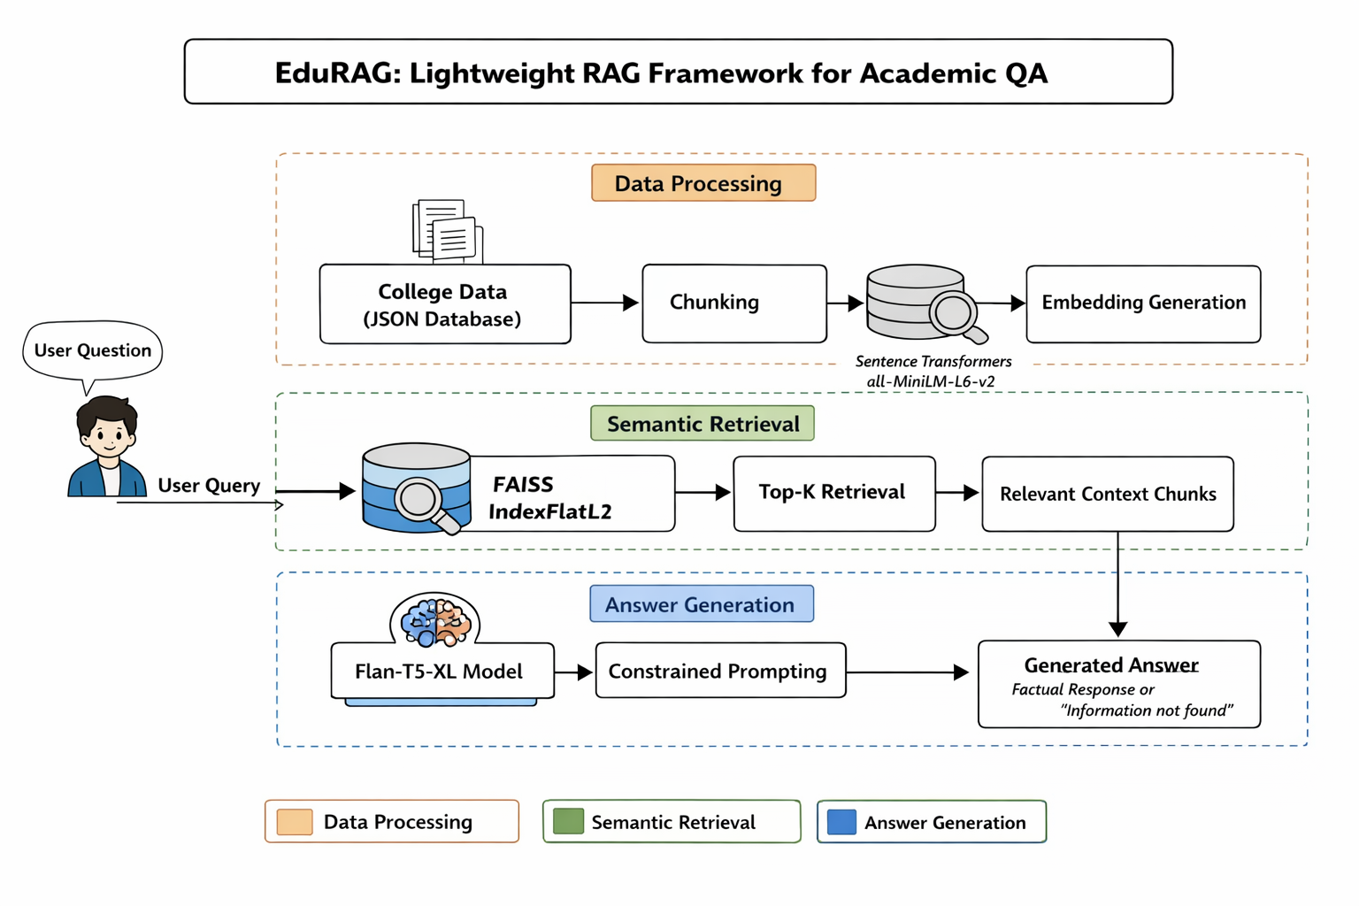
Title: EduRAG: A Lightweight RAG framework for Academic QA
Proposed Architecture

Slide 20
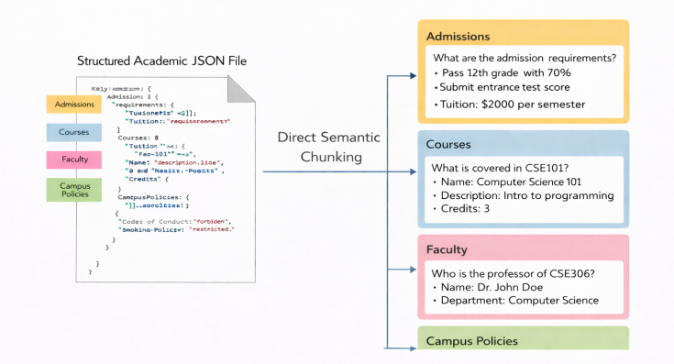

Title: EduRAG: A Lightweight RAG framework for Academic QA
Proposed Algorithm
1. Data Ingestion & Preprocessing
Collect structured academic data (JSON format)
Apply direct semantic chunking (preserves context)
Maintain data integrity for courses, admissions, policies
2. Embedding Generation
Convert text chunks → vector embeddings
Model: Sentence-Transformers (all-MiniLM-L6-v2)
Output: High-dimensional semantic vectors
$$v_{i}=f_{embedding}\left(D_{i}\right)$$

Slide 21
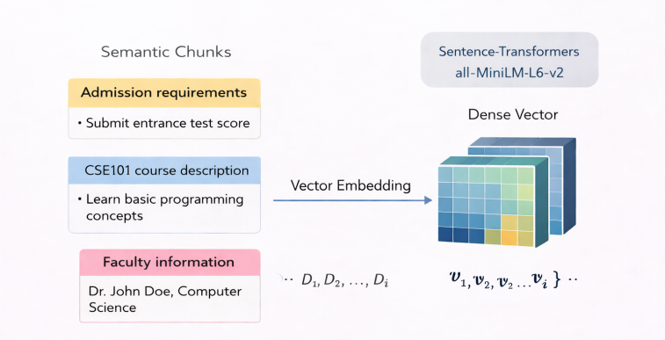
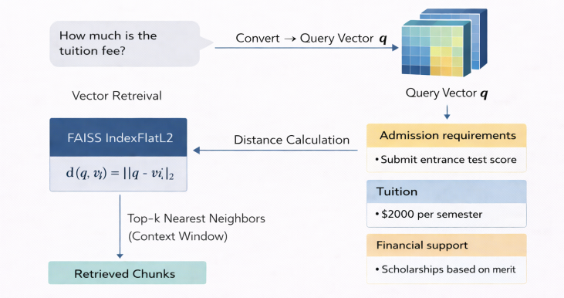

Title: EduRAG: A Lightweight RAG framework for Academic QA
Proposed Algorithm
3. Vector Indexing (FAISS)
Store embeddings using FAISS IndexFlatL2
Enables fast similarity search on CPU
Optimized for low-resource environments
5. Semantic Retrieval (Top-K)
Retrieve Top-K nearest chunks
Ensures only relevant academic context is selected
Forms trusted context (C)
4. Query Processing
User query → converted to query vector
Compute similarity using L2 distance
$$d\left(q , v_{i}\right)=\sqrt{\sum{(}\left.q_{j}−v_{i,j}{\left.)\right.}^{2}\right.}$$

Slide 22
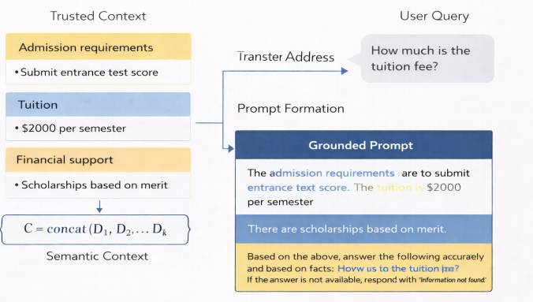

Title: EduRAG: A Lightweight RAG framework for Academic QA
Proposed Algorithm
6. Context Construction
Concatenate retrieved chunks → Context Block
Acts as “source of truth”
7. Grounded Answer Generation
Input: Query (Q) + Context (C)
Model: Flan-T5-XL
Uses constrained prompting
$A=G\left(Prompt\left(Q , C\right)\right)$
8. Hallucination Control Logic
If similarity < threshold → return “Information Not Found”
Ensures 100% factual grounding

Slide 23
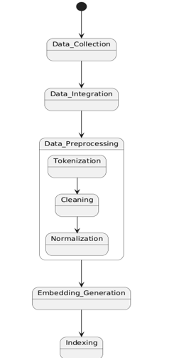
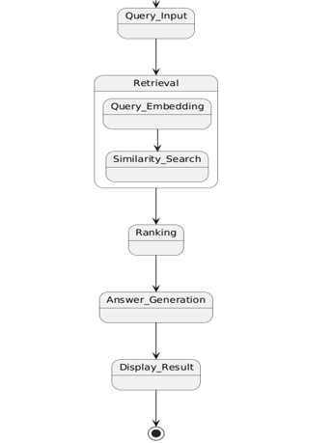
Title: EduRAG: A Lightweight RAG framework for Academic QA
UML DIAGRAM: State chart

Slide 24
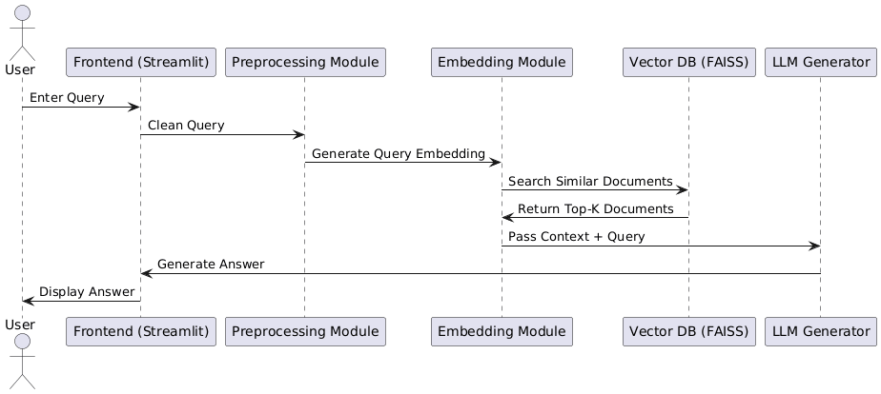
Title: EduRAG: A Lightweight RAG framework for Academic QA
UML DIAGRAM: Sequence Diagram

Slide 25
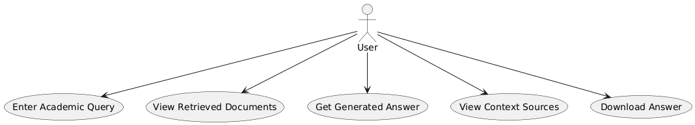
Title: EduRAG: A Lightweight RAG framework for Academic QA
UML DIAGRAM: Use Case Diagram

Slide 26
Title: EduRAG: A Lightweight RAG framework for Academic QA

Slide 27
Title: EduRAG: A Lightweight RAG framework for Academic QA
Implementation ( Source code )
https://colab.research.google.com/drive/1L-OcaX-6hiZ-TD15r13VvPRWW8qIq4wY#scrollTo=A1hGTaS0kqPF
https://github.com/sairamarava/edurag

Slide 28
Title: EduRAG: A Lightweight RAG framework for Academic QA
Conclusion
EduRAG presents a lightweight and efficient RAG-based system for academic question answering, ensuring accurate and context-grounded responses.
It combines semantic retrieval with controlled generation to minimize hallucination and improve reliability.
The system operates effectively on CPU-based environments, making it suitable for low-resource institutions.
Its structured data approach and modular design enhance scalability and ease of deployment.
Overall, EduRAG demonstrates that high-quality QA systems can be built with minimal computational cost.

Slide 29
Title: EduRAG: A Lightweight RAG framework for Academic QA
Future Scope
EduRAG can be extended by integrating larger and more advanced language models to improve reasoning and answer quality.
The system can be enhanced with real-time data updates and dynamic knowledge bases for up-to-date academic information.
Future improvements include multi-modal support (text, PDFs, images) and voice-based interaction for better accessibility.
Scalability can be increased by deploying the system on cloud platforms with optimized indexing techniques.
Additionally, incorporating personalized learning assistance and analytics can transform EduRAG into a full-fledged intelligent academic assistant.

Slide 30
Title: EduRAG: A Lightweight RAG framework for Academic QA
References
Li, Zongxi, Zijian Wang, Weiming Wang, Kevin Hung, Haoran Xie, and Fu Lee Wang. "Retrieval-augmented generation for educational application: A systematic survey." Computers and Education: Artificial Intelligence 8 (2025): 100417.
Guo, Zirui, Lianghao Xia, Yanhua Yu, Tian Ao, and Chao Huang. "Lightrag: Simple and fast retrieval-augmented generation." arXiv preprint arXiv:2410.05779 2, no. 3 (2024).
Sidorov, Denis. "Lightweight Retrieval-Augmented Generation System for Technical Support in Domain-Specific ERP Platforms." Available at SSRN 5332731 (2025).
Fan, Tianyu, Jingyuan Wang, Xubin Ren, and Chao Huang. "Minirag: Towards extremely simple retrieval-augmented generation." arXiv preprint arXiv:2501.06713 (2025).
Ji, Xu, Luo Xu, Landi Gu, Junjie Ma, Zichao Zhang, and Wei Jiang. "RAP-RAG: A Retrieval-Augmented Generation Framework with Adaptive Retrieval Task Planning." Electronics 14, no. 21 (2025): 4269.
Chang, Chia-Yuan, Zhimeng Jiang, Vineeth Rakesh, Menghai Pan, Chin-Chia Michael Yeh, Guanchu Wang, Mingzhi Hu et al. "Main-rag: Multi-agent filtering retrieval-augmented generation." In Proceedings of the 63rd Annual Meeting of the Association for Computational Linguistics (Volume 1: Long Papers), pp. 2607-2622. 2025.
Asl, Mohammad Aghajani, Majid Asgari-Bidhendi, and Behrooz Minaei-Bidgoli. "Fair-rag: Faithful adaptive iterative refinement for retrieval-augmented generation." arXiv preprint arXiv:2510.22344 (2025).
Zhang, Jintao, Guoliang Li, and Jinyang Su. "Sage: A framework of precise retrieval for rag." In 2025 IEEE 41st International Conference on Data Engineering (ICDE), pp. 1388-1401. IEEE, 2025.
Zhou, Jiawei, and Lei Chen. "OpenRAG: Optimizing RAG End-to-End via In-Context Retrieval Learning." arXiv preprint arXiv:2503.08398 (2025).
Yang, Peiru, Xintian Li, Zhiyang Hu, Jiapeng Wang, Jinhua Yin, Huili Wang, Lizhi He et al. "HeteRAG: A Heterogeneous Retrieval-augmented Generation Framework with Decoupled Knowledge Representations." arXiv preprint arXiv:2504.10529 (2025).
Huwiler, Daniel, Kurt Stockinger, and Jonathan Fürst. "VersionRAG: Version-Aware Retrieval-Augmented Generation for Evolving Documents." arXiv preprint arXiv:2510.08109 (2025).
Wu, Ruofan, Youngwon Lee, Fan Shu, Danmei Xu, Seung-won Hwang, Zhewei Yao, Yuxiong He, and Feng Yan. "Composerag: A modular and composable rag for corpus-grounded multi-hop question answering." arXiv preprint arXiv:2506.00232 (2025).
Hu, Yuntong, Zhihan Lei, Zhongjie Dai, Allen Zhang, Abhinav Angirekula, Zheng Zhang, and Liang Zhao. "Cg-rag: Research question answering by citation graph retrieval-augmented llms." In Proceedings of the 48th International ACM SIGIR Conference on Research and Development in Information Retrieval, pp. 678-687. 2025.
Cheng, Mingyue, Yucong Luo, Jie Ouyang, Qi Liu, Huijie Liu, Li Li, Shuo Yu et al. "A survey on knowledge-oriented retrieval-augmented generation." arXiv preprint arXiv:2503.10677 (2025).
Genesis, Jeanie. "Retrieval-Augmented Text Generation: Methods, Challenges, and Applications." (2025).

Slide 31
Title: EduRAG: A Lightweight RAG framework for Academic QA
Any Queries..???

Slide 32
Title: EduRAG: A Lightweight RAG framework for Academic QA
Thank You

